Slide 1
“NextSteps Online: Topics Covered and How TSN Coordinators Can Help Patients Connect”
Presented By:
Dr. Nathan Parmer, PsyD, ABPP, HSPP
NextSteps Co-Creator, NextSteps Online Facilitator
Eileen Flores, MSW, LCSW
National TSN Coordinator, American Trauma Society

Slide 2
Webinar Agenda
What is NextSteps?
What Topics are covered to support trauma survivors in recovery?
What should TSN Coordinators consider before referring a survivor to online NextSteps?
What is the process that a survivor can register and successfully complete NextSteps?

Slide 3
What is NextSteps?
Evidence-based, 6 week class offered throughout the year to help survivors manage life after serious injury
Focuses on building strengths, developing new coping skills, and expanding self-efficacy after trauma
Helps survivors increase knowledge and self-management potential while connecting with other trauma survivors online

Slide 4
What is NextSteps?
Survivors complete two, 20 minute interactive lessons each week at any time convenient to them
Survivors participate in one weekly online chat led by Dr. Parmer at a scheduled evening time
Survivors can share their story, ask questions, connect with Dr. Parmer, connect with other survivors in online chats

Slide 5
What is NextSteps?
NextSteps is FREE and confidential, designed for trauma survivors who have experienced a physical injury
Survivors can learn and review the weekly lessons at their own pace
Survivors can access online NextSteps from anywhere if they have a computer and an Internet connection

Slide 6
What Topics are covered to support trauma survivors in recovery?
Date |  | Topic |  | Live Chat
February 14-20 |  | Lessons 1 & 2: Taking Stock Explore where you are on the Road to Recovery, learn more about self-management, and begin to practice self-management tools. |  | February 20 at 7:00 pm ET
February 21-27 |  | Lessons 3 & 4: Moving Forward Identify problems related to your injury, set goals, and begin to use problem-solving to find solutions. |  | February 27 at 7:00 pm ET
February 28-March 6 |  | Lessons 5 & 6: Managing Emotions I Learn about emotional adjustment, including myths and common reactions following a traumatic injury and begin to use tools to improve your mood. |  | March 6 at 7:00 pm ET
March 7- 13 |  | Lessons 7 & 8: Managing Emotions II Learn to identify, reduce, and break the cycle of anxiety by confronting negative thinking and using relaxation. |  | March 13 at 7:00 pm ET
March 14- 20 |  | Lessons 9 & 10: Friends and Family Begin to get the help you need from family and friends by learning the signs of a healthy relationship, getting the most of your support system and recognizing helpful and unhelpful “help”. |  | March 20 at 7:00 pm ET
March 21-27 |  | Lesson 11 & 12: Looking Ahead Learn how to overcome setbacks that may arise in your recovery. Take time to reflect on the future and celebrate the progress you’ve made. |  | March 27 at 7:00 pm ET

Slide 7
What Topics are covered to support trauma survivors in recovery?
Week 1: Lessons 1 & 2: Taking Stock
Survivors can relate to a detour on their life journey
Survivors identify major problem areas in healing
Survivors reflect on how trauma has changed What they do on a daily basis (adjusting to the new normal)
Survivors reflect on how trauma has not changed certain aspects of themselves or how they are developing new strengths

Slide 8
What Topics are covered to support trauma survivors in recovery?
Week 2: Lessons 3 & 4:
Moving Forward
Survivors learn how to simplify overwhelming problems into smaller, attainable goals
Survivors focus on setting goals that are specific, measurable, and realistic
Survivors learn and practice effective communication with family, friends, medical providers, etc.

Slide 9
What Topics are covered to support trauma survivors in recovery?
Week 3: Lessons 5 & 6: Managing Emotions I
Survivors learn about common emotional responses after trauma
Survivors reflect on signs of major depression and other negative effects of injury
Survivors practice mindfulness techniques and learn ways to build positive emotions

Slide 10
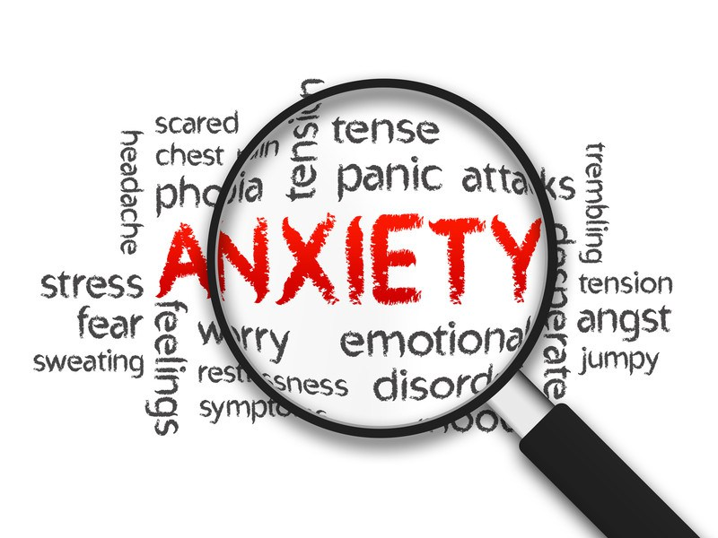
What Topics are covered to support trauma survivors in recovery?
Week 4: Lessons 7 & 8: Managing Emotions II
Survivors identify signs of Anxiety and PTSD after trauma
Survivors learn about the Anxiety Cycle
Survivors practice how to reduce negative thinking patterns through cognitive and mindfulness techniques

Slide 11
What Topics are covered to support trauma survivors in recovery?
Week 5: Lessons 9 & 10: Friends and Family
Survivors focus on communicating effectively with support people
Survivors identify the differences between “helpful” vs. “unhelpful help” in recovery
Survivors reflect on how their injury has also affected their family and friends

Slide 12
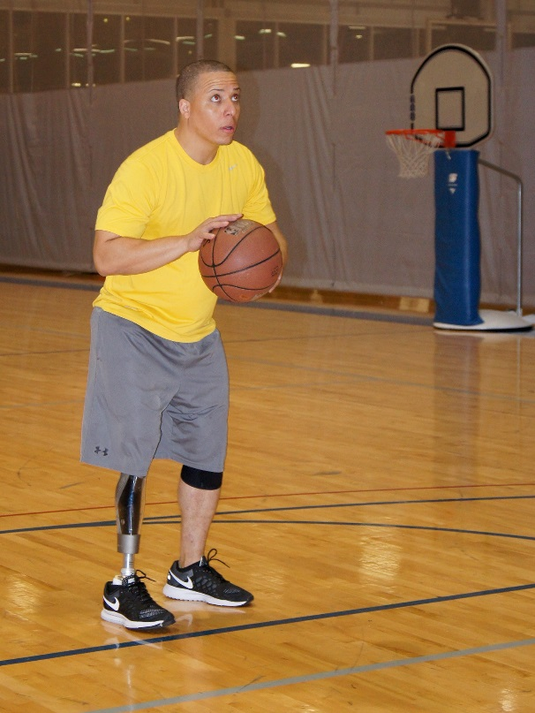
What Topics are covered to support trauma survivors in recovery?
Week 6: Lesson 11 & 12: Looking Ahead
Survivors focus on goals that they want to accomplish in the future
Survivors focus on overcoming challenging setbacks in recovery
Survivors can reflect and share how NextSteps has given them new tools and perspectives

Slide 13
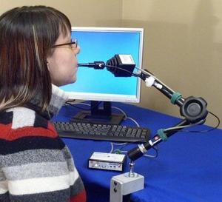
What should TSN Coordinators consider before referring a survivor to online NextSteps?
The survivor needs to be at a point in recovery that he/she is ready to move forward (different for everyone)
The survivor must have access to a computer and internet
The survivor must have the cognitive and physical ability/adaptive equipment to complete basic computer skills

Slide 14
What is the process that a survivor can register and successfully complete NextSteps?
Survivor can register at either website: https://www.traumasurvivorsnetwork.org/pages/nextsteps
http://nextstepsonline.org
After signing up, Survivors must check e-mail to validate their registration in the class
Dr. Parmer will e-mail follow up instructions for class participation

Slide 15
For additional questions, please contact:
Eileen Flores, MSW, LCSW
National TSN Coordinator
American Trauma Society
eflores@amtrauma.org
704-351-7882

